Slide 1
Property and Casualty Insurance An Inside Scoop to HNW Personal Insurance (Home, Auto, Umbrella) Michelle Hirsch Sr. Vice President Brunswick Companies October 21, 2021

Slide 2
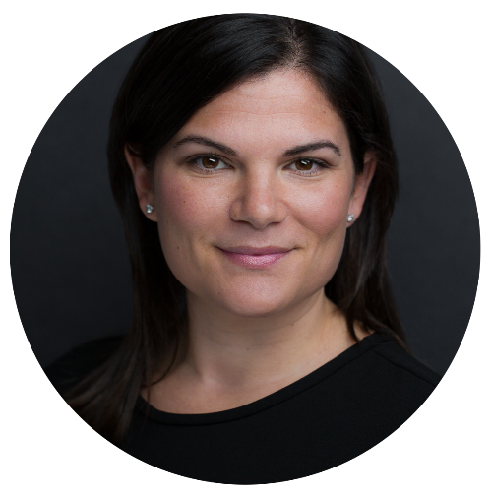
About Your Presenter
Third generation family-owned insurance and risk management consulting firm, serving clients nationwide.
Provides P&C insurance services to companies, aspiring and accomplished individuals, families and professional athletes.
Bachelors Degree from Penn State University and MBA from Case Western University Weatherhead School of Management
Part of Crain’s Cleveland Business:
Twenty in their 20’s (2008)
Forty Under 40 (2017)
Michelle Hirsch
Sr. Vice President
Brunswick Companies

Slide 3
Our Solutions
Risk Management Services
Insurance
Commercial
Personal
Professional
Surety Products
Claims Management

Slide 4
Program Objectives
As wealth changes, insurance protection needs to change with it. However, having an insurance strategy as part of a wealth management portfolio is often overlooked. This course provides a high-level overview of personal insurance and its unique risks for the affluent; it also examines the importance of an insurance audit and how preparing this analysis strengthens the relationship between clients and their advisors.
YOUR CLIENT = COLLECTIBLE

Slide 5
Importance of Insurance Audit
As wealth changes, often the insurance protection does not…
Determine if the wealth created has the proper protection.
Identify the exposures of risk and the options for transferring to a policy.
Validate that the insurance has maintained pace with personal assets and property changes.
74%
Consumers lack key coverages and high enough limits

Slide 6
Chief Risk Officer
Personal Insurance is more than just peace of mind, it’s about financial protection via a CHIEF RISK OFFICER.
Our approach is:
Take time to know you, your family, and your assets
Assess the full scope of risk exposure to identify the right level of coverage
Tailor a personal program to protect and ensure those goals
Secure and actively manage coverage programs
Ensure your coverage adapts with you as often as needed

Slide 7
The Growth Opportunity
Nearly 40% of successful individuals would consider switching to an advisor who provided P&C support.
85% of successful families believe it is of significant importance that their advisors help them navigate all of their financial matters.
77% of successful individuals want their advisors to provide P&C insurance support.
Only 28% of advisors address clients’ P&C needs
*Source - Oliver Wyman, Global Management Consulting Firm

Slide 8
Personal Insurance Solutions
Standard or Customized Plans Designed to Evolve with Your Needs:
Homes/Land
Fine Arts/Jewelry
Automobiles/Collector Autos
Recreational Vehicles
Personal Collections
Umbrella/Excess Liability
State of the Art Electronics
Watercraft/Yachts
Personal Employees

Slide 9
Universe of Risk Advisors
Independent Brokers
Captive Agents
Direct Response Companies

Slide 10
High Net Worth – Who Qualifies?
Home
$500K+
Replacement Cost
Additional
Residences
Assets
Luxury Vehicles
Family
Multi-Gen
Wealth
Kidnap & Ransom
Entertains/
Hosts Events
Total Net Worth
Family Trustee,
LLC’s, Biz Auto
More
Professional Athletes
& Celebrities
Board Membership & Non-Profit Activities
Domestic Employees
Jewelry, Art & Collectibles

Slide 11
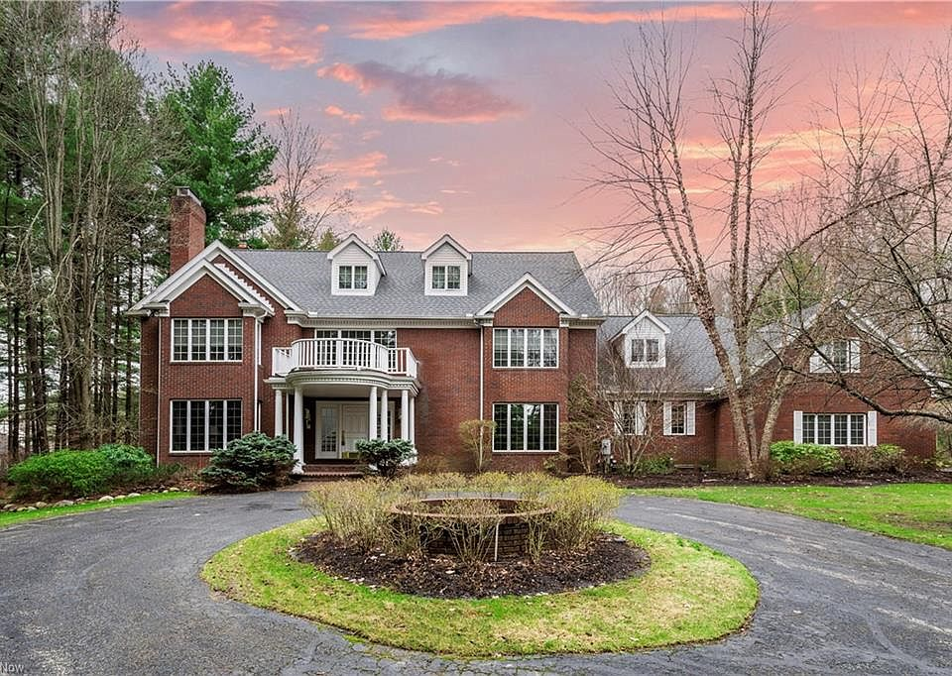
Shaker Heights, OH
6,800 sq ft 5 bedroom 6 bath
Current estimated market value: $960K
Insurance REPLACEMENT cost value: $1.8M ($265/sqft)

Slide 12
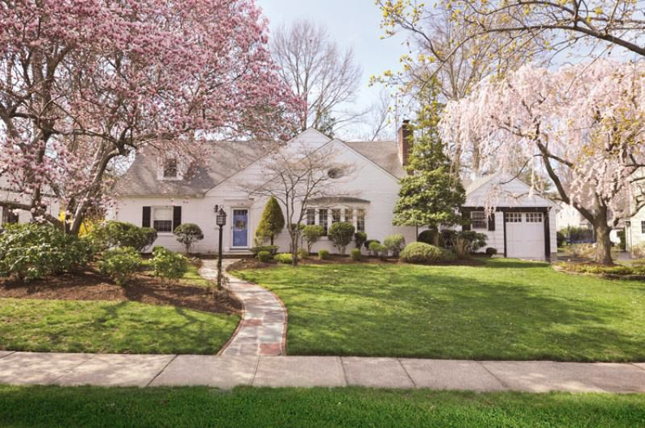
Westfield, NJ
1,800 sq ft 3 bedroom 2 bath
Current estimated market value: $960K
Insurance REPLACEMENT cost value: $750K ($416/sqft)

Slide 13
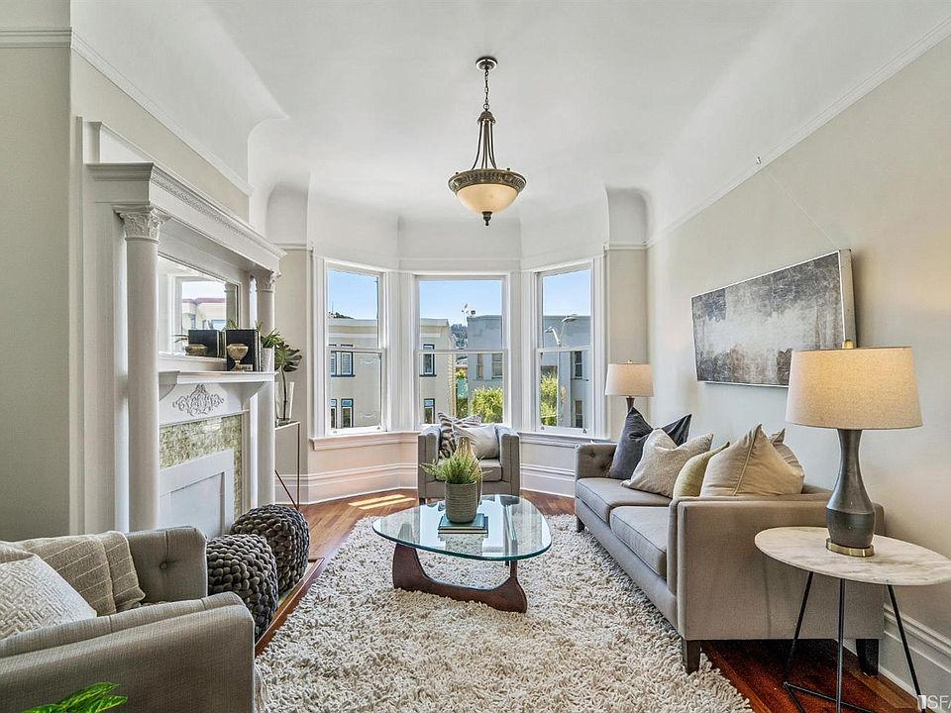
San Francisco, CA
680 sq ft 1 bedroom 1 bath
Current estimated market value: $960K
Insurance REPLACEMENT cost value: $575K ($845/sqft)

Slide 14
Every policy is different…
Every policy is different…

Slide 15
Home/Condo/Co-Op
70% have never or rarely had a professional assessment on their home or possessions
Guaranteed Replacement Cost
Cash Settlement
Additional Living Expenses/Loss of Use
Sewer Backup/Water
Flood
76% lacked flood insurance
Hurricane & Earthquake
Trusts

Slide 16
Total Loss Scenarios
 | Carrier A | Carrier B | Carrier C
Dwelling Amount | $1,700,000 | $1,700,000 | $1,700,000
Actual Cost of Rebuild | $2,200,000 | $2,200,000 | $2,200,000
Policy Provision | No Extended Replacement Cost | 20% Extension | Guaranteed
Amount of Insurance Payout | $1,700,000 | $2,040,000 | $2,200,000
Impact to Client | $500,000 | $160,000 | $0

Slide 17
Home/Condo/Co-Op
70% have never or rarely had a professional assessment on their home or possessions
Guaranteed Replacement Cost
Cash Settlement
Additional Living Expenses/Loss of Use
Sewer Backup/Water
Flood
76% lacked flood insurance
Hurricane & Earthquake
Trusts

Slide 18
Jewelry/Fine Arts/Collectibles
62% Lack Jewelry Insurance Entirely
Establishing Value
Blanket and/or Scheduled
Agreed Value
Updated Appraisals
Home Safe/Safety Deposit Box Credits
Claim Fulfillment
Pairs & Sets
Replacement vs. Cash Option
Worldwide Coverage/In-Transit

Slide 19
Auto
Agreed Value vs. Actual Cash Value
Choice of Repair Shop
Original Equipment Manufacturers’ Parts
Collectible Cars
Loss of Use
Youthful/Adult Children Operators
Uninsured/Underinsured

Slide 20
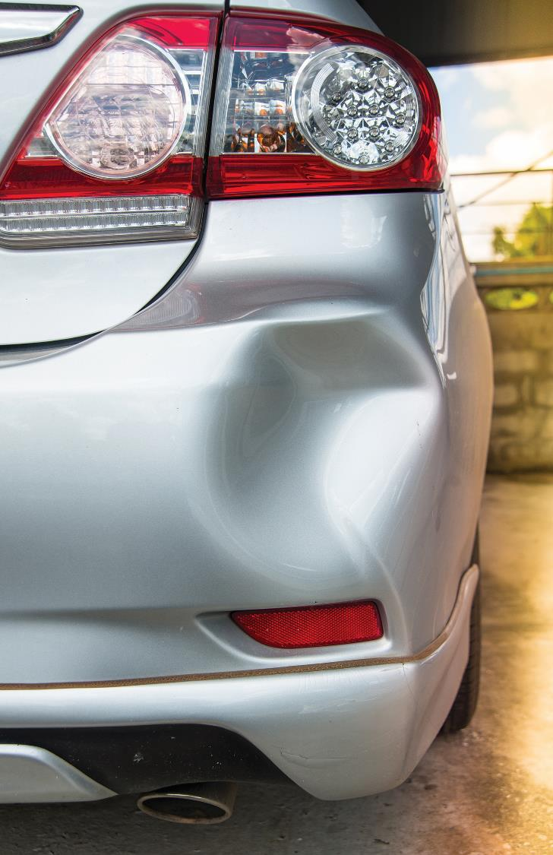
Claims
Universal Claims Database
Severity vs. Frequency
5 Year Look Back
Adjuster Experience
TransGlobal Adjusting Corp., a wholly-owned subsidiary of Brunswick Companies

Slide 21
Personal Liability/Umbrella
Why an Umbrella?
What does it cover?
How much coverage?
Punitive Damages
What are Group Umbrellas?

Slide 22
Cyber
Social Engineering
Unauthorized Transfer or Payment
Criminal Deception
Forgery or Alteration of Checks
Acceptance of Counterfeit Money
Identity Fraud
No crypto.. YET!

Slide 23
Travel
Evacuation
Medical Assistance
Returned Remains/Vehicles
Trip Reimbursement
* More than 100 miles from home

Slide 24
COVID-19
Inspections and Claims
Auto Discounts
Additional Household Members
Vacation Rentals
Special Events

Slide 25
BPC – 5 STEP PROCESS
1
2
3
4
5
DISCOVERY
APPROACH THE MARKETS
GAP ANALYSIS & LOSS MITIGATION REPORT
IMPLEMENTATION
PERSONAL RISK OFFICER

Slide 26
Premium Carriers

Slide 27
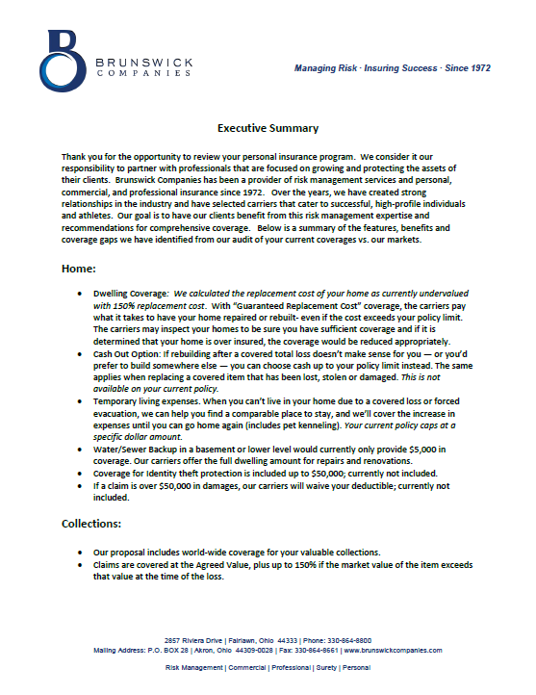
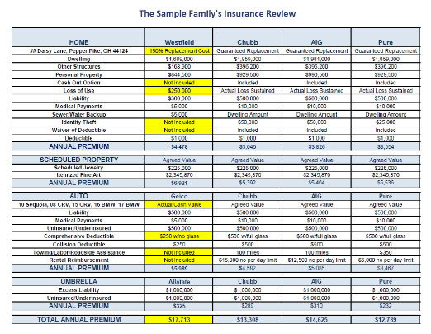
Proposal Summary

Slide 28
Engaging Your Client
New Item on Annual Checklist
Complimentary Audit
Copies of Policies
Event = Review
Personal Testimonial
162%
Increase in audits performed in the last year

Slide 29
What do we need to quote?
Current Policies
All Drivers’ license numbers
All Dates of birth & occupations
Fax or Email to Brunswick
Switch insurance carrier at any time, existing paid premium will be prorated and refunded.

Slide 30
At Brunswick Companies, we believe in protecting our client’s aspirations and achievements as they evolve.

Slide 31
Questions?

