Slide 1
Real-Life, Strategic Charitable Planning Techniques
October 21, 2021

Slide 2
Agenda
Philanthropic trends, & opportunities
Popular Charitable Giving Vehicles
Questions
& Answers
Real-World Case Studies

Slide 3
Charitable Giving Landscape… in a Pandemic
In 2020 charitable giving increased 3.8% (adjusted for inflation)
Individual Giving
$324.10 billion
(up 2.2%)
Foundation Giving
$88.55 billion
(up 17%)
Bequest Giving
$41.91 billion
(up 10.3%)
Corporate Giving
$16.88 billion
(down 6.1%)
Bequests
Giving USA 2021 The Annual Report on Philanthropy for the Year 2020
All numbers are current dollars
Notes:
$22.78 billion increase in giving from 2019 (5.1% growth, 3.8% adjusted for inflation)
All except two charitable subsectors experienced an increase in giving in 2020:
- e.g., religion, education, human services, animals, etc., experienced an increase in giving
- the two exceptions were arts & culture and health (in person events/fundraisers were cancelled; arts & culture often declines in economic downturns)
Factors that impacted charitable giving in 2020:
(1) Health of stock market → S&P grew 16.3% over previous year (types of giving related to asset growth benefitted)
(2) GDP declined by 2.3% (affects corporate giving), corporate pre-tax dollars declined
(3) CARES Act helped boost economy, grew personal income
(4) Unforeseen events & circumstances: i.e., the pandemic spurred giving (though much broader than natural disaster)

Slide 4
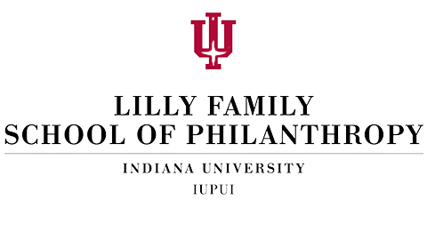
Charitable Giving Outlook for 2021 and Beyond
Current economic indicators suggest the U.S. will experience "broad philanthropic growth” over the next couple of years:
Total giving is projected to increase by 4.1% in 2021 and 5.7% in 2022.
Individuals and households are expected to increase their giving by 6.0% in 2021 and by 3.9% in 2022.
Giving by corporations is predicted to increase by 4.3% in 2021 and by 6.4% in 2022
Source: Lilly Family School of Philanthropy, https://blog.philanthropy.iupui.edu/2021/02/19/the-outlook-for-charitable-giving/
Notes:
The overall growth projected in the report is based on several assumptions, namely that the economy will grow rapidly in 2021 as more people are vaccinated and the need for social-distancing mandates declines.
The report recognizes that 2020 was an extraordinarily volatile year, and unforeseen circumstances and events could further shift the charitable landscape

Slide 5
Popular Charitable Giving Vehicles
Donor Advised Funds
Most popular charitable vehicle that offers simplicity and flexibility for individuals, families, or corporations
Tax deduction today, distribute to charity later
Supporting Organizations
For donors who want more formalized philanthropy
Tax advantages of a public charity over private foundation
Private foundation alternative
IRC 509(a)(3) organization designation; separate tax ID issued
Board of directors and governance
Grant applications; review and evaluation
Custom investment policy
Named Funds
Popular and effective estate planning vehicle used to create a perpetual testamentary fund
Designated Fund: benefits specific organizations as determined by the donor
Field of Interest Fund: benefits donor’s favorite charitable fields (e.g., education, arts); Cleveland Foundation uses expertise to determine grantees

Slide 6
More Popular Giving Vehicles
CRT (Charitable Remainder Trust)
Donor makes gift to trust in exchange for regular payments back to donor.
Remainder to charity upon termination.
Payments can be fixed (CRAT) OR vary with value of trust (CRUT)
Payout rate and term of trust can vary
CLT (Charitable Lead Trust)
Essentially the opposite of a remainder trust
Charity gets stream of income; remainder goes back to donor or another beneficiary
Effective wealth transfer vehicle under the right conditions

Slide 7
Case Studies: Liquidity Event
Donna owns an industrial manufacturing business worth $10 million ($0 basis) that she’s decided to sell.
She wants to use 20% of the proceeds for charitable purposes.
Option 1: Sell, then gift.
Capital gains tax takes 20%; $400,000 of the $2 million gift portion.
Option 2: Gift, then sell.
Depending on charitable vehicle, can gift/deduct up to the entire $2m.
Private foundation: limited to cost basis; other limitations
DAF: deduct fair market value, retain advisory rights and legacy

Slide 8
Gifts of C Corp Stock
Relatively simple
Opportunity for corporation to buy back stock
(i.e. “charitable bailout/redemption”)
Works with a variety of donation types
Donor
Gift of
C-corp
stock
Stock sold
DAF @
Cleveland
Foundation
Buyer
Cash
Donor advises
grants to
charities
Charities

Slide 9
Case Studies: Bunching Gifts
Why is this important? Tax Cuts & Jobs Act!
Increased Standard Deduction
III
Reduction In Charitable Giving
Reduction In Itemization
II
I
About 30% of taxpayers itemized their deductions in recent years
Individuals are estimated to reduce charitable giving by $13B annually
Head of household: $9,550 to $18,000
Joint filers: $13,000 to $24,000
Single filer: $6,500 to $12,000
20.4M households are estimated to itemize deductions in 2018, down from 48.7M in 2017
Tax benefits can still be achieved under the new tax rules

Slide 10
Case Study: Bunching Gifts
$135,400
$36,200
$8,688
Tax savings = $5,376 (at 24%)
Notes:
Adjust to 50/0/0/0
Year 1 Deduction up to 61K
Total deduction up to 135,400
Difference increased by 13,800 to 36,200
For a total tax savings of $8,688

Slide 11
Case Study: Convert Private Foundation to DAF
Background
$9m private family foundation
Lots of grants and other administrative work
Three Directors disbursed throughout USA
Existing plan for the PF to eventually distribute to DAF
Why Convert?
Streamlined communication
Centralized coordination and administration of all administration and grantmaking
The Process
Cleveland Foundation reviews all grantmaking, other activity, and assets
Seamless coordination for an easy transition

Slide 12
Private Foundation vs. Donor Advised Fund
Private Foundation | Donor Advised Fund
Separate nonprofit | [sponsoring organization] Fund with Donor input on Grantmaking
Private Foundation Deductibility: -20% AGI for appreciated property -30% AGI cash 2% taxation of investment income Minimum payout of 5% Detailed annual filing with IRS Staff support or actively engaged volunteers needed to handle requests and grant making support Trustees have complete control and responsibility of distributions and management of assets Public record of giving | Public Charity Deductibility: -30% AGI for appreciated property -60% AGI cash No taxation on income No payout minimum All filings handled by sponsoring organization Donor recommends grants Giving can be anonymous

Slide 13
Case Studies: Simplifying Giving
Marcus makes $50,000 in gifts to charities every year.
Appreciated stock.
~ 10 charities; $500 - $10,000
Marcus opens DAF, funds with $50,000 appreciated stock
Recommend grants through our online portal
Only has one gift receipt for all his giving

Slide 14
Case Studies: Family Philanthropy
Background
Gen A’s desire to pass legacy of giving to Gen B through a multi-million-dollar fund
Family wasn’t sure how to execute grants in a way that would teach Gen B how to run the fund.
Professional advisor connected family to Cleveland Foundation; understood the family would desire personalized and customizable services as family’s needs changed
Protocol
Cleveland Foundation chosen for resources we provide,
e.g. strategy, mapping policy and procedure.
DAF chosen for flexibility
Proactive approach with family
Formal annual review, with additional connections as needed
Notes:
* Senior generation want to create a multi-million dollar fund to pass philanthropic values on to future generations.
They brought a lot of ideas about philanthropy to the table but were struggling with how to design and execute a grant strategy that would teach the younger generation how to do things like review and vet proposals and decide on grants.
After a comprehensive review of the services that the foundation provides and conversation about how we could add value, we decided that the best route for them was a Donor Advised Fund because, as we discussed earlier, it provides such a high degree of flexibility paired with administrative support that makes it relatively easy to operate.
From there we’ve taken a really proactive approach in getting and keeping the entire family involved in the process with frequent conversations as well as a formal annual review to discuss what they accomplished over the past year and where they want to go in the future.

Slide 15
Case Study: Gift of Real Estate
Facts
Darlene has owned vacation home for 30 years and doesn’t want to maintain/manage anymore.
Value = $400k; Adjusted Cost Basis = $100k
Option 1 – Sell, then make gifts
At 15% federal capital gains rate, she pays $45k tax
Leaving $355k for giving
Option 2 – Gift directly to charity (including DAF)
Larger gift to charity
Avoid capital gains tax
Larger tax deduction
Other Creative Options
Use real estate to fund charitable trust
Use real estate to fund gift annuity

Slide 16
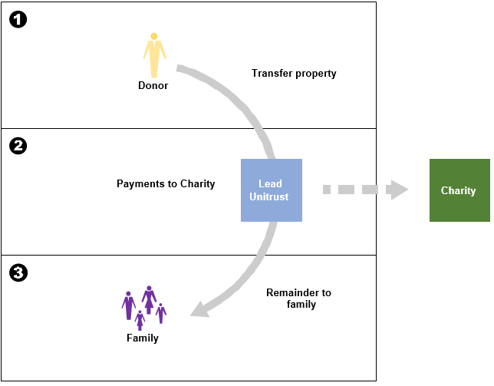
Case Study: CLT + DAF
Miguel, owned appreciating property that he wanted to transfer to his kids.
He needed to reduce his gift/estate tax, and he also wanted to make gifts to charity.
DAF
Donor recommends grants to charities
Name DAF as the beneficiary of a CLT
Enhances the CLT by providing donor with flexibility and advisory rights.
Or a charitable account to pass on to heirs.

Slide 17
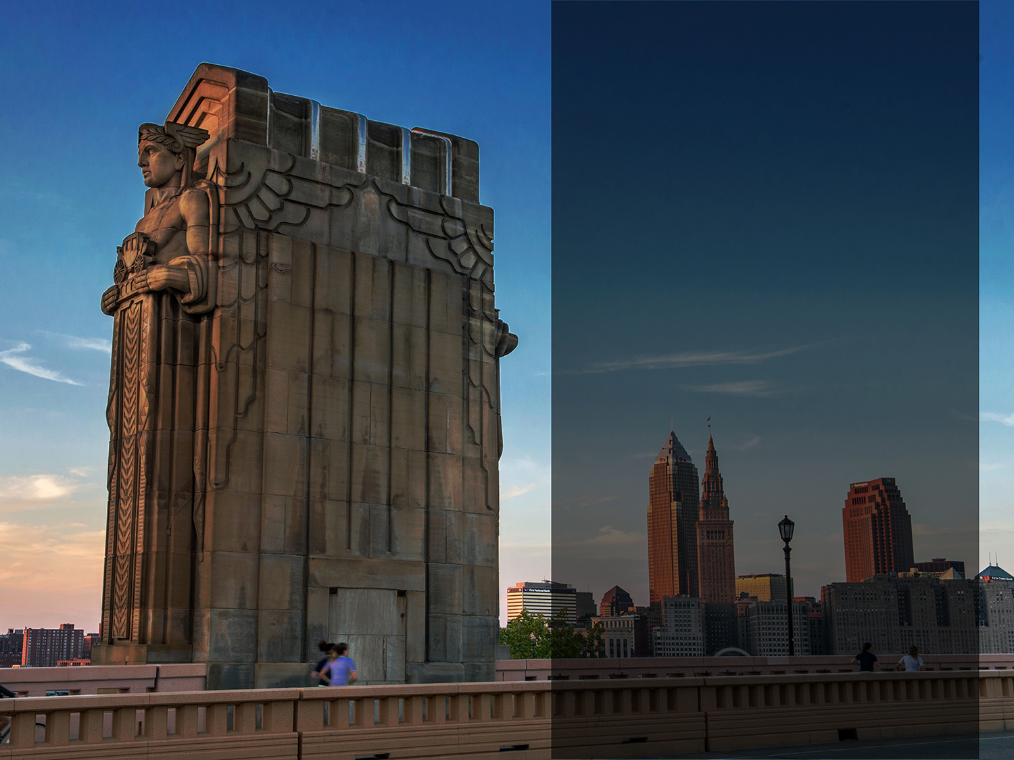
s
Terri Bradford Eason, MBA
Senior Director,
Advancement Equity Initiatives
TEason@CleveFdn.org
216.650.3824
Dave Stokley, JD
Gift Planning Advisor
Dstokley@CleveFdn.org
216.685.2003

Slide 18
Terri Bradford Eason, MBA
Senior Director, Advancement Equity Initiatives
Terri Bradford Eason is responsible for developing and overseeing the equity initiatives aligned with the foundation’s strategic priorities, as a member of the Advancement Department. Terri is also focused on developing and executing cultivation and fundraising activities that help individuals establish current and deferred philanthropic funds, legacy gifts and charitable giving strategic plans. As such, Terri works closely with professional advisors and their clients to identify, create and provide charitable planning options tailored to achieve specific philanthropic goals.
Terri joined the Foundation in October 2008 after gaining two decades of experience in the financial services industry. She had several positions with National City (now PNC) and supported several functions including wealth management, relationship management, new business development, and both private and corporate banking. As director of nonprofit business services, she was responsible for new business development and relationship management of nonprofit and higher education organizations. Throughout her tenure, Terri was dedicated to quality service for which she received the company’s NCC Excel Award for extraordinary client and community service. She also was the recipient of the YWCA Women of Professional Excellence Award, TLOD Status of Women Award, the NCNW Phenomenal Women of Extraordinary Leadership and Service Award and the National Coalition of 100 Black Women, Inc.’s Woman of Vision award.
Terri has served the nonprofit community as a director on several area nonprofit boards, including Recovery Resources, Junior Achievement, the Women’s City Club Foundation and the Legacy Village Lyndhurst Community Fund Committee. In addition, she is the Former President of the Alpha Omega Chapter of Alpha Kappa Alpha Sorority, Incorporated, and Former Chairman of the Alpha Omega Foundation, Incorporated. Currently, she serves on the Board of Notre Dame College, Cleveland Hearing and Speech Center (Past-Board President), Northern Ohio Charitable Gift Planners Council, Milestone Autism Resources, Inc., AKA Educational Advancement Foundation, Inc. (At-Large Director) and member of the Board of Trustees for Ohio North First Ecclesiastical Jurisdiction (Former Board Chairman).
Terri is a member of the National Black MBA Association, Inc., NAACP, Beta Gamma Sigma National Honor Society, Cleveland Chapter of Links, Inc., Top Ladies of Distinction, Inc. (Treasurer) and Jack & Jill of America, Inc. She earned her Master of Business Administration degree from Cleveland State University and a Bachelor of Arts degree from Penn State University. Terri resides in South Euclid, Ohio with her husband Clayton Eason, Sr.

Slide 19
Dave Stokley, JD
Gift Planning Advisor
Dave joined the Cleveland Foundation’s Advancement team in July 2019. He focuses on providing individuals, families and organizations with information regarding current and deferred charitable giving options. In addition, Dave works closely with professional advisors and their clients to identify those options that will achieve specific philanthropic planning goals.
Prior to joining the Foundation, Dave ran The Cleveland Orchestra’s gift planning program for several years, providing charitable gift, tax and estate planning services to donors, overseeing planned giving marketing efforts, drafting and reviewing gift agreements, and providing educational opportunities on gift planning to colleagues. Dave previously held positions at the Cleveland Museum of Art and Stark & Knoll LPA.
Dave serves as the Immediate Past-President of Northern Ohio Charitable Gift Planners, a local educational group for the gift planning profession. He is also on the Board of Directors of the Cleveland Baseball Federation. Dave maintains memberships with the National Association of Charitable Gift Planners, Northern Ohio Charitable Gift Planners, and Estate Planning Council of Cleveland. He earned his law degree from Ohio State University following undergraduate work at Wittenberg University.

Slide 21
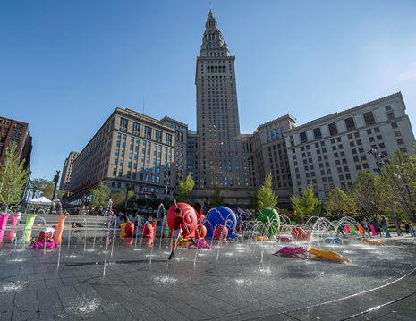
Overview of the Cleveland Foundation
Statistical Highlights
One of the country’s largest community foundations
$3B endowment
$90M average annual grants
Grants totaling $130M + in 2020
Over $2B in grants since 1914
Mission Statement
To enhance the lives of all residents of Greater Cleveland, now and for generations to come, by
Working together with our donors to build community endowment
Address needs through grantmaking, and
Provide leadership on key community issues.

Slide 22
Investment Alliance Program
You can still manage your client’s assets
Requirements:
$500,000 minimum relationship
At firm level; can be cumulative across multiple donors
Manage within Cleveland Foundation investment policy
Comply with ongoing monitoring, reporting, and review
Cleveland Foundation opens relationship with investment advisor
Donor creates DAF at Cleveland Foundation
DAF funded – investment advisor begins managing assets.
Ongoing monitoring

Slide 23
Asset Types The Cleveland Foundation Can Accept
Real estate
Personal Residence
Farmland
Cash
Marketable securities
Closely held securities
S-Corp vs. C-Corp
Partnership/LLC interests
Personal Property
Artwork
Intellectual Property
Collectibles
Alternative Assets
Life Insurance
Retirement Assets

Slide 24
Planned Giving Expertise
We offer a robust team of Planned Giving Professionals with legal, charitable planning and tax expertise providing the following services:
Illustrations and calculations on a variety of Planned Giving vehicles:
Testamentary
Split-interest
Gifts by Will or Trust
Beneficiary Designations for Retirement Plans
Beneficiary Designations and/or Ownership of Life Insurance
Charitable Remainder Trust
Charitable Lead Trust
Charitable Gift Annuity

Slide 25
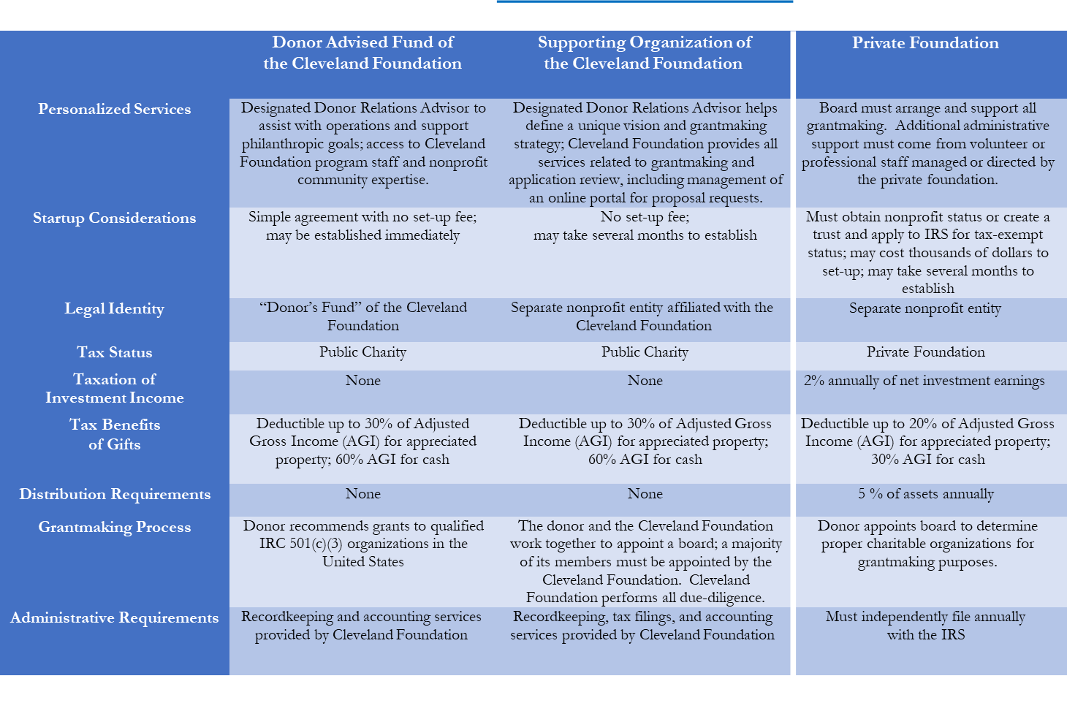
Comparing DAFs, Supporting Orgs, and Private Foundations

Slide 26
Why work with the Cleveland Foundation?
Client
Create and Implement Charitable Plans with Advisor
Provide Information on Community Needs
Deliver Grantmaking Expertise & Admin Services
Identify Charitable Interests & Motivations
Match Charitable Interests with Tax Planning Needs

