Slide 1
Portfolio Construction
Objective-based investing in a style-box world
Figures are past results and are not predictive of results in future periods.
Investments are not FDIC-insured, nor are they deposits of or guaranteed by a bank or any other entity, so they may lose value.
For financial professionals only. Not for use with the public.

Slide 2
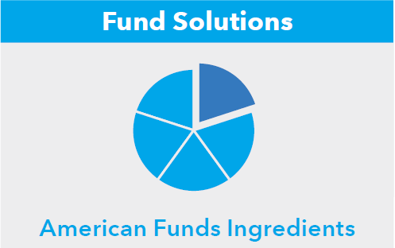
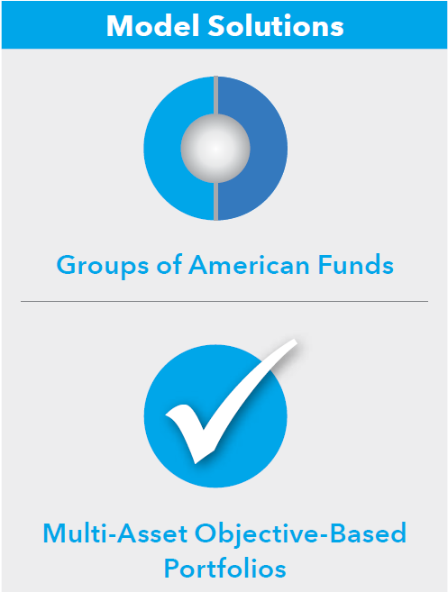
At Capital Group, we believe…
Objective-based portfolio construction can help investors achieve better outcomes.
Portfolios must address a broader range of risks.
Bottom-up flexibility expands opportunities for success.
The right ingredients make all the difference and, when used in portfolios, can be greater than the sum of their parts.
Portfolios built by experienced investment managers are better positioned for success.
Finally, we believe:
Our approach to portfolio composition makes us well-positioned to help you build stronger portfolios that align to your clients’ goals.
For financial professionals only. Not for use with the public.

Slide 3
Investment objectives can help align client goals to asset allocation
Build Wealth
Spend Wealth
Investor
Goals
Conserve Wealth
Growth | Growth and Income | Distribution Income | Preservation and Income
For investors seeking long-term growth of capital | Long-term growth of capital and income | Income with downside protection and sufficient long-term growth of capital | Current income and capital preservation
Investment
Objectives
Portfolios
  Style boxes tell you where to invest; investment objectives tell you how to invest
For financial professionals only. Not for use with the public.

Slide 4

Style boxes were meant to be descriptive, not prescriptive
Future?
1924
Objective-Based Mutual Funds
Funds seek objectives of appreciation, income or
preservation that align intuitively to client goals
2000–today
1950–1980
Liability-Driven Investing; Goal-Based Planning
Modern Portfolio Theory and Indexing
Success equals meeting goals, not just matching risk tolerance or beating market benchmarks.
The “market” is most diversified, lowest risk portfolio; success should be measured relative to market
1980–2000
Style Analysis and Style-Box Funds
Style analysis developed to evaluate performance,
but adopted for portfolio construction
  The move to goals-based wealth management is likely to revitalize the practice of objective-based investing
For financial professionals only. Not for use with the public.

Slide 5
Investment objectives can lead to differentiated outcomes
Average Results Over Rolling 10-Year Periods for U.S.-Focused American Funds (for 40 years ended June 30, 2017)
  Objective-based funds give advisors a broader toolkit to manage risks across a client life cycle
*Data based on R-6 share class.
Sources: Capital Group, MSCI. American Funds sample includes equally weighted U.S.-focused funds in each objective category with at least four decades of history. Growth includes AMCAP Fund and The Growth Fund of America; Growth & Income includes The Investment Company of America, Washington Mutual Investors Fund and American Mutual Fund; Income includes The Income Fund of America; Fixed Income includes The Bond Fund of America. Average annualized return is a simple arithmetic average of monthly returns (annualized) while annualized standard deviation of returns measures the standard deviation of monthly returns (also annualized).
For financial professionals only. Not for use with the public.

Slide 6
Risk is not just volatility … but that the client might fail to meet his/her goal
Different perspective on risk: 1976–2016
Risk = volatility
Volatility
Risk = insufficient appreciation
Downside growth of $100k (rolling 20 yrs)
Risk = outliving retirement savings
Downside withdrawal (rolling 20 yrs)
Riskiest investment
Riskiest investment
Riskiest investment
Sources: Standard & Poor's, Morningstar, MSCI
* In the left panel, volatility is the annualized standard deviation of monthly returns. In the middle panel, we assume $100k starting assets, and calculate average accumulated savings over worst 5% of scenarios across all rolling 20-yr periods. The right panel calculates the maximum inflation-adjusted withdrawal rate measured as a percentage of starting assets that maintains a positive average asset balance over the worst 5% of scenarios across all rolling 20-yr periods.
For financial professionals only. Not for use with the public.

Slide 7
Equity “glide path within the glide path” can help mitigate key client risks
100
Average annual total return (%)
Fixed income funds
90
Balanced funds
80
70
60
Medium-yielding equity funds
(1.5% to 3%)
50
40
30
Highest yielding equity/ equity-income funds
(above 3%)
20
Lowest yielding equity funds
(below 1.5%)
10
0
45
40
35
30
25
20
15
10
5
Retirement
+5 After
+10 After
+15 After
+20 After
+25 After
+30 After
  Change the amount of equities, and the type of equities
For financial professionals only. Not for use with the public.

Slide 8
Each fixed income fund may play a distinct role in portfolio construction
100
Average annual total return (%)
90
Inflation protection
Capital preservation
80
70
Income
60
Diversification from equity
50
40
30
Equity and balanced funds
20
10
0
45
40
35
30
25
20
15
10
5
Retirement
+5 After
+10 After
+15 After
+20 After
+25 After
+30 After
  Change the amount of fixed income, and the type of fixed income
For financial professionals only. Not for use with the public.

Slide 9
Bottom-up flexibility can provide more precision in asset allocation
Regional exposure of the top 5 companies per GIC sector (5 companies x 10 sectors = 50 stocks)
Average
30
20
Index return | 2007 | 2008 | 2009 | 2010 | 2011 | 2012 | 2013 | 2014 | 2015 | 2016 | Average
Non-U.S. | 11.6% | -43.1% | 32.5% | 8.2% | -11.7% | 17.9% | 23.3% | -4.5% | -0.4% | 1.5% | 3.5%
U.S. | 5.5% | -37.0% | 26.5% | 15.1% | 2.1% | 16.0% | 32.4% | 13.7% | 1.4% | 12.0% | 8.8%
  Flexibility on size, style and domicile provides skillful managers an enhanced toolkit to deliver on objectives
* We use S&P 500 and MSCI EAFE to represent U.S. and non-U.S. equities, respectively.
For financial professionals only. Not for use with the public.

Slide 10
Flexible American Funds have a record of superior returns…
20 years ended December 31, 2016
Global equity funds
Multi-asset funds
Capital World Growth and Income Fund
New Perspective Fund
SMALLCAP World Fund
American Balanced Fund
Capital Income Builder
Income Fund of America
MSCI ACWI Small Cap
60/40
S&P 500/Bbg US Agg
S&P 500
70/30
MSCI ACWI/Bbg U.S. Agg
MSCI ACWI
Bbg U.S. Agg
* Data based on R-6 share class.
For financial professionals only. Not for use with the public.

Slide 11
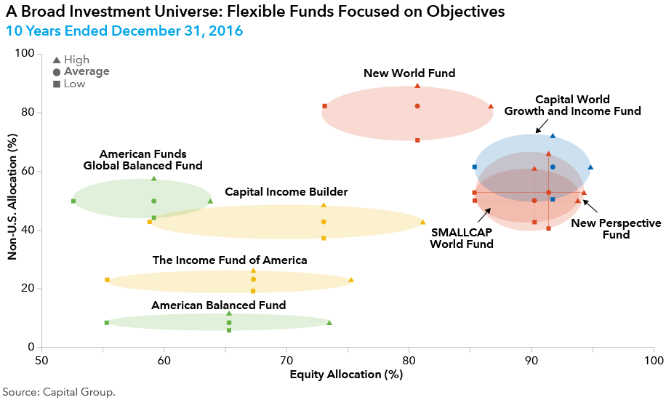
…with disciplined flexibility
For financial professionals only. Not for use with the public.

Slide 12
Objective-based investing can complement traditional portfolio construction
Traditional Portfolio
Construction
Objective-Based Portfolio
Construction
Risk Measures
Primarily standard deviation
Risk Measures
Standard deviation, plus risks related to market events and investor behavior
Step 1:
Asset Allocation
Seeks exposures:
Geography
Style
Market cap
Asset Allocation
Seeks outcomes:
Growth
Income
Preservation
Step 2:
Success Metrics
Excess return compared to benchmark
Success Metrics
Ending wealth
Withdrawal support
Wealth preservation
Step 3:
For financial professionals only. Not for use with the public.

Slide 13
American Funds Investment Results
Average Annual Total Returns for the Period Ending September 30, 2017
  Figures shown are past results for Class R-6 shares and are not predictive of results in future periods. Current and future results may be lower or higher than those shown. Share prices and returns will vary, so investors may lose money. Investing for short periods makes losses more likely. Funds results shown are at net asset value with all distributions reinvested. Class R shares do not pay an up-front or deferred sales charge. For current information and month-end results, visit americanfunds.com.
Funds | 1 Year | 5 Years | 10 Years | Expense Ratio
Growth
AMCAP Fund® | 17.51 | 14.91 | 8.34 | 0.36
EuroPacific Growth Fund® | 20.63 | 9.51 | 3.65 | 0.50
The Growth Fund of America® | 20.23 | 15.44 | 7.66 | 0.33
The New Economy Fund® | 26.70 | 16.31 | 8.60 | 0.47
New Perspective Fund® | 21.22 | 12.86 | 6.75 | 0.45
New World Fund® | 20.58 | 6.97 | 3.55 | 0.65
SMALLCAP World Fund® | 18.51 | 12.64 | 5.78 | 0.71
Investment results assume all distributions are reinvested and reflect applicable fees and expenses. Expense ratios are as of each fund’s prospectus available at the time of publication. When applicable, investment results reflect fee waivers and/or expense reimbursements, without which results would have been lower. Please see americanfunds.com for more information.
Class R-6 shares were first offered on May 1, 2009. Class R-6 share returns prior to the date of first sale are hypothetical based on Class A share returns without a sales charge, adjusted for typical estimated expenses. Please see each fund’s prospectus for more information on specific expenses.
We offer a range of share classes designed to meet the needs of retirement plan sponsors and participants. The different share classes incorporate varying levels of advisor compensation and service provider payments. Because Class R-6 shares do not include any recordkeeping payments, expenses are lower and results are higher. Other share classes that include recordkeeping costs have higher expenses and lower results than Class R-6.
For financial professionals only. Not for use with the public.

Slide 14
American Funds Investment Results
Average Annual Total Returns for the Period Ending September 30, 2017
  Figures shown are past results for Class R-6 shares and are not predictive of results in future periods. Current and future results may be lower or higher than those shown. Share prices and returns will vary, so investors may lose money. Investing for short periods makes losses more likely. Funds results shown are at net asset value with all distributions reinvested. Class R shares do not pay an up-front or deferred sales charge. For current information and month-end results, visit americanfunds.com.
Funds | 1 Year | 5 Years | 10 Years | Expense Ratio
Growth and Income
American Funds Developing World Growth and Income FundSM | 15.80 | 3.93* | — | 0.93
American Mutual Fund® | 15.82 | 12.84 | 7.39 | 0.30
Capital World Growth and Income Fund® | 18.80 | 11.17 | 4.87 | 0.45
Fundamental Investors® | 20.69 | 14.92 | 7.58 | 0.31
International Growth and Income Fund SM | 17.89 | 7.23 | 7.92* | 0.58
The Investment Company of America® | 16.57 | 14.11 | 6.89 | 0.30
Washington Mutual Investors FundSM | 19.58 | 13.82 | 7.13 | 0.30
* The fund’s lifetime is less than the full period. American Funds Developing World Growth and Income Fund began operations on February 3, 2014 and International Growth and Income Fund began operations on October 1, 2008.
Investment results assume all distributions are reinvested and reflect applicable fees and expenses. Expense ratios are as of each fund’s prospectus available at the time of publication. When applicable, investment results reflect fee waivers and/or expense reimbursements, without which results would have been lower. Please see americanfunds.com for more information.
Class R-6 shares were first offered on May 1, 2009. Class R-6 share returns prior to the date of first sale are hypothetical based on Class A share returns without a sales charge, adjusted for typical estimated expenses. Please see each fund’s prospectus for more information on specific expenses.
We offer a range of share classes designed to meet the needs of retirement plan sponsors and participants. The different share classes incorporate varying levels of advisor compensation and service provider payments. Because Class R-6 shares do not include any recordkeeping payments, expenses are lower and results are higher. Other share classes that include recordkeeping costs have higher expenses and lower results than Class R-6.
For financial professionals only. Not for use with the public.

Slide 15
American Funds Investment Results
Average Annual Total Returns for the Period Ending September 30, 2017
  Figures shown are past results for Class R-6 shares and are not predictive of results in future periods. Current and future results may be lower or higher than those shown. Share prices and returns will vary, so investors may lose money. Investing for short periods makes losses more likely. Funds results shown are at net asset value with all distributions reinvested. Class R shares do not pay an up-front or deferred sales charge. For current information and month-end results, visit americanfunds.com.
Funds | 1 Year | 5 Years | 10 Years | Expense Ratio
Equity-Income
Capital Income Builder® | 10.43 | 7.82 | 4.32 | 0.30
The Income Fund of America® | 11.72 | 9.51 | 5.95 | 0.28
Balanced
American Balanced Fund® | 12.78 | 10.72 | 7.02 | 0.29
American Funds Global Balanced FundSM | 9.18 | 7.58 | 6.98* | 0.54
* The fund’s lifetime is less than the full period. American Funds Global Balanced Fund began operations on February 1, 2011.
Investment results assume all distributions are reinvested and reflect applicable fees and expenses. Expense ratios are as of each fund’s prospectus available at the time of publication. When applicable, investment results reflect fee waivers and/or expense reimbursements, without which results would have been lower. Please see americanfunds.com for more information.
Class R-6 shares were first offered on May 1, 2009. Class R-6 share returns prior to the date of first sale are hypothetical based on Class A share returns without a sales charge, adjusted for typical estimated expenses. Please see each fund’s prospectus for more information on specific expenses.
We offer a range of share classes designed to meet the needs of retirement plan sponsors and participants. The different share classes incorporate varying levels of advisor compensation and service provider payments. Because Class R-6 shares do not include any recordkeeping payments, expenses are lower and results are higher. Other share classes that include recordkeeping costs have higher expenses and lower results than Class R-6.
For financial professionals only. Not for use with the public.

Slide 16
American Funds Investment Results
Average Annual Total Returns for the Period Ending September 30, 2017
  Figures shown are past results for Class R-6 shares and are not predictive of results in future periods. Current and future results may be lower or higher than those shown. Share prices and returns will vary, so investors may lose money. Investing for short periods makes losses more likely. Funds results shown are at net asset value with all distributions reinvested. Class R shares do not pay an up-front or deferred sales charge. For current information and month-end results, visit americanfunds.com.
Funds | 1 Year | 5 Years | 10 Years | Expense Ratio
Bond
American Funds Corporate Bond Fund® | 2.06 | 4.06* | — | 0.79
American Funds Emerging Markets Bond Fund® | 8.09 | 9.68* | — | 0.87
American Funds Inflation Linked Bond Fund® | -0.17 | 0.35* | — | 0.42
American Funds Mortgage Fund® | 1.22 | 2.06 | — | 0.31
American Funds Strategic Bond FundSM | 1.95 | 3.79* | — | 0.70
American High-Income Trust® | 9.10 | 5.20 | 6.04 | 0.36
The Bond Fund of America® | 0.96 | 2.39 | 3.38 | 0.25
Capital World Bond Fund® | 0.32 | 1.13 | 3.56 | 0.53
Intermediate Bond Fund of America® | 0.48 | 1.21 | 2.49 | 0.27
Short-Term Bond Fund of America® | 0.91 | 0.75 | 1.50 | 0.35
U.S. Government Securities Fund® | –0.02 | 1.49 | 3.75 | 0.27
The expense ratios for Corporate Bond Fund are estimated. The investment adviser for Corporate Bond Fund, Emerging Markets Bond Fund and Strategic Bond Fund is currently reimbursing a portion of other expenses. The reimbursement will be in effect through at least April 7, 2018. The adviser may elect at its discretion to extend, modify or terminate the reimbursement at that time. Please see the fund’s most recent prospectus for details.
* The fund’s lifetime is less than the full period. American Funds Corporate Bond Fund began operations on December 14, 2012; American Funds Emerging Markets Bond Fund began operations on April 22, 2016; American Funds Inflation Linked Bond Fund began operations on December 14, 2012; American Funds Strategic Bond Fund began operations on March 18, 2016; and Short-Term Bond Fund of America began operations on October 2, 2006.
Investment results assume all distributions are reinvested and reflect applicable fees and expenses. Expense ratios are as of each fund’s prospectus available at the time of publication. When applicable, investment results reflect fee waivers and/or expense reimbursements, without which results would have been lower. Please see americanfunds.com for more information.
Class R-6 shares were first offered on May 1, 2009. Class R-6 share returns prior to the date of first sale are hypothetical based on Class A share returns without a sales charge, adjusted for typical estimated expenses. Please see each fund’s prospectus for more information on specific expenses.
We offer a range of share classes designed to meet the needs of retirement plan sponsors and participants. The different share classes incorporate varying levels of advisor compensation and service provider payments. Because Class R-6 shares do not include any recordkeeping payments, expenses are lower and results are higher. Other share classes that include recordkeeping costs have higher expenses and lower results than Class R-6.
For financial professionals only. Not for use with the public.

Slide 17
Market Indexes Results
Average Annual Total Returns for the Period Ending September 30, 2017
Index | 1 Year | 5 Years | 10 Years | Expense Ratio
Bloomberg Barclays U.S. Aggregate | 0.07 | 2.06 | 4.27 | —
MSCI ACWI ex USA | 19.61 | 6.97 | 1.28 | —
MSCI ACWI Small Cap | 19.23 | 11.94 | 6.16 | —
S&P 500 | 18.61 | 14.22 | 7.44 | —
Market indexes are unmanaged and, therefore, have no expenses. Investors cannot invest directly in an index. There have been periods when the fund has lagged the index. Please see slides 20 and 21 for index information.
For financial professionals only. Not for use with the public.

Slide 18
Important Information
Investors should carefully consider the investment objectives, risks, charges and expenses of the American Funds. This and other important information is contained in each fund’s prospectus and summary prospectus, which can be obtained from a financial professional and should be read carefully before investing.

Slide 19
Risk Disclosure
Investing outside the United States involves risks, such as currency fluctuations, periods of illiquidity and price volatility, as more fully described in the prospectus. These risks may be heightened in connection with investments in developing countries.
The return of principal for bond funds and for funds with significant underlying bond holdings is not guaranteed. Fund shares are subject to the same interest rate, inflation and credit risks associated with the underlying bond holdings. Investments in mortgage-related securities involve additional risks, such as prepayment risk, as more fully described in the prospectus. Higher yielding, higher risk bonds can fluctuate in price more than investment-grade bonds, so investors should maintain a long-term perspective.
While not directly correlated to changes in interest rates, the values of inflation linked bonds generally fluctuate in response to changes in real interest rates and may experience greater losses than other debt securities with similar durations.
Small-company stocks entail additional risks, and they can fluctuate in price more than larger company stocks.The use of derivatives involves a variety of risks, which may be different from, or greater than, the risks associated with investing in traditional cash securities, such as stocks and bonds.
If used after September 30, 2017, this presentation must be accompanied by the most recent American Funds quarterly statistical update.

Slide 20
Index Definitions
Bloomberg Barclays U.S. Aggregate Index represents the U.S. investment-grade fixed-rate bond market. This index is unmanaged, and its results include reinvested dividends and/or distributions but do not reflect the effect of sales charges, commissions, account fees, expenses or taxes.
Ibbotson Small Company Stocks Index is represented by the fifth capitalization quintile of stocks on the NYSE from 1926 to1981 and the performance of the Dimensional Fund Advisors (DFA) Micro Cap Fund thereafter.
MSCI All Country World Index is a free float-adjusted market capitalization weighted index that is designed to measure equity market results in the global developed and emerging markets. The index consists of more than 40 developed and emerging market country indexes. This index is unmanaged, and its results include reinvested dividends and/or distributions but do not reflect the effect of sales charges, commissions, account fees, expenses or taxes.
MSCI All Country World Small Cap Index is a free float-adjusted market capitalization-weighted index that is designed to measure equity market results of smaller capitalization companies in both developed and emerging markets. Results reflect dividends net of withholding taxes.
The MSCI USA High Dividend Yield Index is based on the MSCI USA Index, its parent index, and includes large and mid cap stocks. The index is designed to reflect the performance of equities in the parent index (excluding REITs) with higher dividend income and quality characteristics than average dividend yields that are both sustainable and persistent. The index also applies quality screens and reviews12-month past performance to omit stocks with potentially deteriorating fundamentals that could force them to cut or reduce dividends.
Standard & Poor’s 500 Composite Index is a market capitalization-weighted index based on the results of approximately 500 widely held common stocks. This index is unmanaged, and its results include reinvested dividends and/or distributions but do not reflect the effect of sales charges, commissions, account fees, expenses or taxes.
Indexes are unmanaged and do not reflect the effect of sales charges, commissions, account fees, expenses or taxes. Investors cannot invest directly in an index.

Slide 21
Data Sources
Bloomberg® is a trademark of Bloomberg Finance L.P. (collectively with its affiliates, “Bloomberg“). Barclays® is a trademark of Barclays Bank Plc (collectively with its affiliates, “Barclays“), used under license. Neither Bloomberg nor Barclays approves or endorses this material, guarantees the accuracy or completeness of any information herein and, to the maximum extent allowed by law, neither shall have any liability or responsibility for injury or damages arising in connection therewith.
MSCI has not approved, reviewed or produced this report, makes no express or implied warranties or representations and is not liable whatsoever for any data in the report. You may not redistribute the MSCI data or use it as a basis for other indices or investment products.
The S&P 500 is a product of S&P Dow Jones Indices LLC and/or its affiliates and have been licensed for use by Capital Group. S&P Dow Jones Indices LLC, a division of S&P Global, and/or its affiliates. All rights reserved. Redistribution or reproduction in whole or in part is prohibited without written permission of S&P Dow Jones Indices LLC. © 2017
Morningstar. All rights reserved. The information contained herein: (1) is proprietary to Morningstar and/or its content providers; (2) may not be copied or distributed; and (3) is not warranted to be accurate, complete or timely. Neither Morningstar nor its content providers are responsible for any damages or losses arising from any use of this information. Past performance is no guarantee of future results.

